Slide 1

Computer Networks: Switching Techniques & Data Communication Terminologies
DM
by Divija Sri Naidu MADDALA

Slide 2
Circuit Switching: Connecting the Dots
Dedicated Path
Telephone Calls
A physical connection is established between the sender and receiver before data transmission. This connection remains active throughout the communication session.
Classic example: making a phone call. A dedicated circuit is established, allowing for real-time, uninterrupted communication. Think of it as a highway built just for your call.

Slide 3

Message Switching: Relaying the Message
Store and Forward
Email Systems
Messages are broken down into smaller units, transmitted to intermediate nodes, stored, and forwarded to the next destination.
Email is a good example. The message is transmitted, stored, and forwarded by intermediate servers until it reaches the recipient's inbox.

Slide 4



Packet Switching: Efficiently Sharing the Network
Data in Packets
Internet and the Web
Data is divided into packets, each containing a destination address and sequence number. These packets travel independently through the network, taking different routes.
The internet relies heavily on packet switching. When you browse the web, your request is broken into packets, sent to servers, and reassembled at your device.

Slide 5
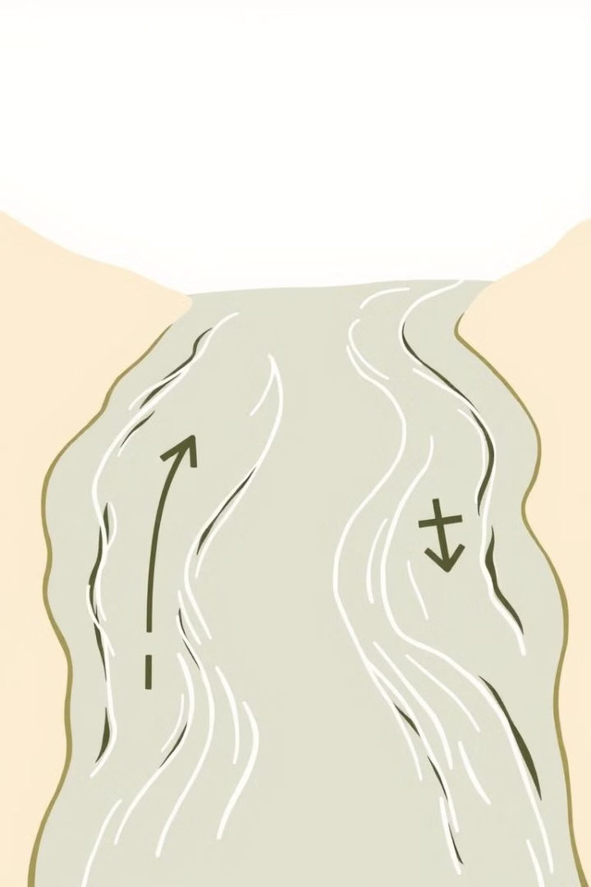


Data Channel: The Highway for Data
Upstream
Downstream
Data sent from your device to the network or server.
Data received from the network or server to your device.

Slide 6

Baud: Measuring Signal Changes
1
Signal Changes
Baud represents the number of signal changes per second. These changes can be transitions between high and low states.

Slide 7
Bits Per Second (bps): Data Transfer Rate
Data Bits
1
bps measures how many bits of data are transmitted per second. It's a fundamental unit for measuring data transfer speed.

Slide 8

Bandwidth: The Network's Capacity
Data Flow Rate
Bandwidth refers to the range of frequencies available for data transmission over a communication channel. It determines the maximum data transfer rate.
1

Slide 9
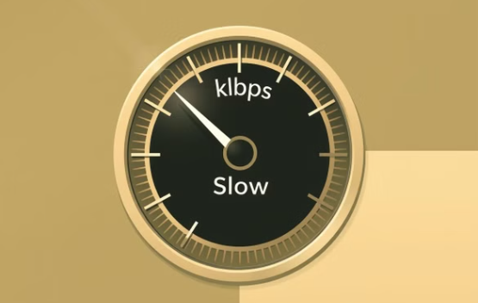


Data Transfer Rates: How Fast Can We Go?

